Slide 1

IT 7611 CONVERSATIONAL AI CHATBOT
CREATIVE AND INNOVATIVE PROJECT
SUPERVISED BY
Dr.M.R.Sumalatha
GUIDED BY
Ms. Lakshmi Harika
SUBMITTED BY
Karthikeyan JM (2018506049)
Dinesh V(2018506028)
Abinaya A (2018506003)
BATCH NO: 20

Slide 2
AIM OF THE PROJECT
To develop a generative based conversational chatbot using Seq2Seq with Attention mechanism for society and enterprise applications.

Slide 3
Introduction
Conversational AI Chatbot using Deep Learning is an interesting problem in the field of Natural Language Processing.
Chatbot is a Software program that generates response based on given input to mimic human conversations in text or voice mode. These applications are designed to simulate human-human interactions.
In the past, methods for constructing chatbot architectures have relied on hand-written rules and templates or simple statistical methods.
With the rise of deep learning, these models were quickly replaced by end-to-end trainable neural networks.

Slide 4
Existing Models
Among current chatbots, many are developed using rule-based techniques, simple machine learning algorithms or retrieval-based techniques which do not generate good results.
Especially when dealing with real world data the sentences may be long enough where it may lead to the failure of the existing models.

Slide 5
Proposed Model
As a solution to this problem we propose Seq2Seq model with attention mechanism using modern-day techniques.
For developing Seq2Seq AI Chatbot, we propose a encoder-decoder attention mechanism architecture. This encoder-decoder will be using Recurrent Neural Network with LSTM (Long-Short-Term-Memory) cells.

Slide 6

What is Sequence-Sequence?
A sequence is an ordered list of symbols. For Ex:
A sequence of webpages visited by a user, ordered by the time of access.
A sequence of words or characters typed on a cellphone by a user, or in a text such as a book.
A sequence of products bought by a customer in a retail store.
A sequence of symptoms observed on a patient at a hospital.
The task of sequence prediction consists of predicting the next symbol of a sequence based on the previously observed symbols. For example, if a user has visited some webpages A, B, C, in that order, one may want to predict what is the next webpage that will be visited by that user to prefetch the webpage.

Slide 7
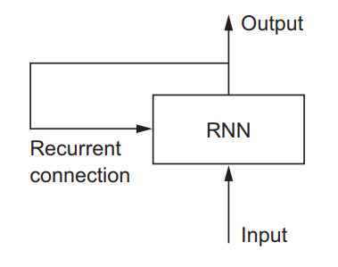
What is RNN?
Recurrent Neural Networks, or RNNs, were designed to work with sequence prediction problems.
Recurrent means the output at the current time step becomes the input to the next time step. At each element of the sequence, the model considers not just the current input, but what it remembers about the preceding elements.
Why RNN?
To maintain word order
To share parameters across the sequence

Slide 8
What is LSTM?
Long Short-Term Memory (LSTM) networks are a type of recurrent neural network capable of learning order dependence(long-term dependencies) in sequence prediction problems.
This is a behavior required in complex problem domains like machine translation, speech recognition, and more.

Slide 9
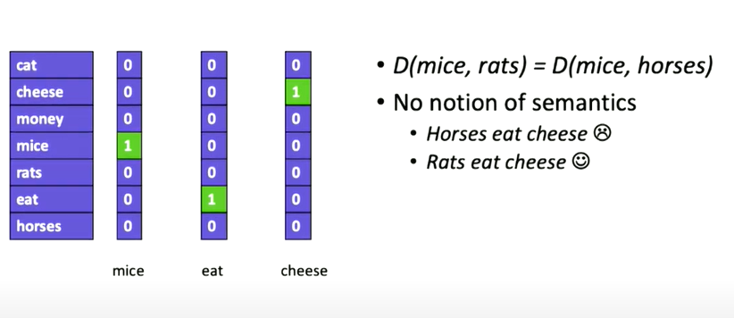
Word Representation: One-hot
No semantic meaning

Slide 10
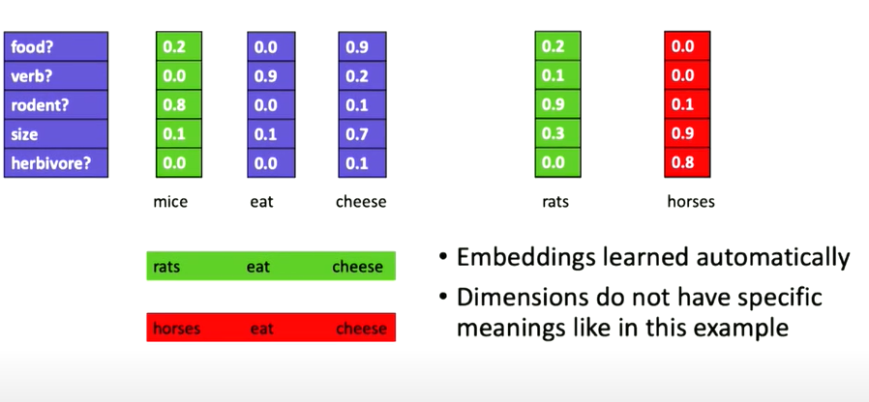
Word Embeddings
Enable semantics.
Measures distance between words in semantic space

Slide 11
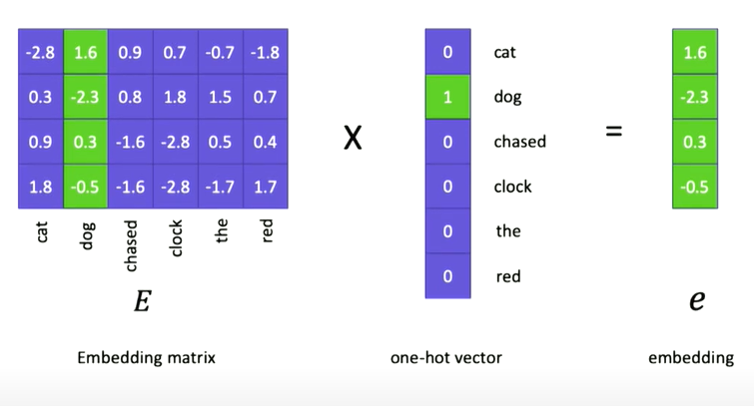
From one-hot to Embeddings
Embedding matrix is a learned parameters of the model.
Embedding vector for the particular word.

Slide 12
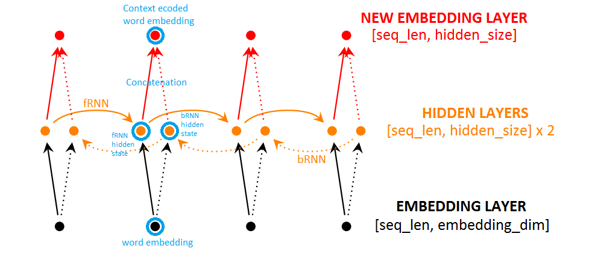
What is BidirectionalRNN?
Bidirectional Recurrent Neural Networks (BRNN) connect two hidden layers of opposite directions to the same output. With this form of generative deep learning, the output layer can get information from past (backwards) and future (forward) states simultaneously.

Slide 13
Seq2Seq model or RNN Encoder-Decoder
An “encoder” RNN reads the source sentence and transforms it into a rich fixed-length vector representation, which in turn in used as the initial hidden state of a “decoder” RNN (context vector) that generates the target sentence.
RNN Encoder–Decoder, consists of two recurrent neural networks (RNN) that act as an encoder and a decoder pair. The encoder maps a variable-length source sequence to a fixed-length vector, and the decoder maps the vector representation back to a variable-length target sequence.

Slide 14
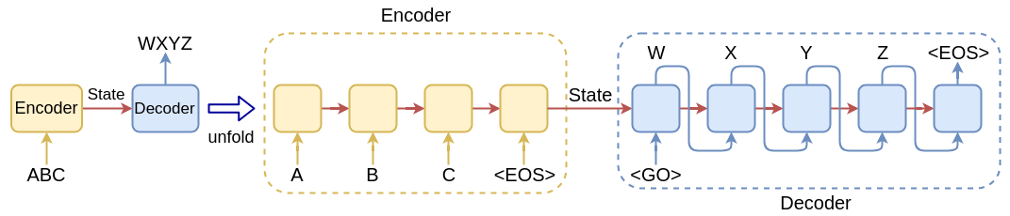
Seq2Seq model / RNN Encoder-Decoder Architecture

Slide 15
Attention Mechanism(Bahdanau Attention):
Freeing the encoder-decoder architecture from the fixed-length internal representation.
Achieved by keeping the intermediate outputs from the encoder LSTM from each step of the input sequence and training the model to learn to pay selective attention to these inputs and relate them to items in the output sequence.
Each time the proposed model generates a word in a translation, it (soft-)searches for a set of positions in a source sentence where the most relevant information is concentrated. The model then predicts a target word based on the context vectors associated with these source positions and all the previous generated target words.
It encodes the input sentence into a sequence of vectors and chooses a subset of these vectors adaptively while decoding the translation. This frees a neural translation model from having to squash all the information of a source sentence, regardless of its length, into a fixed-length vector.

Slide 16
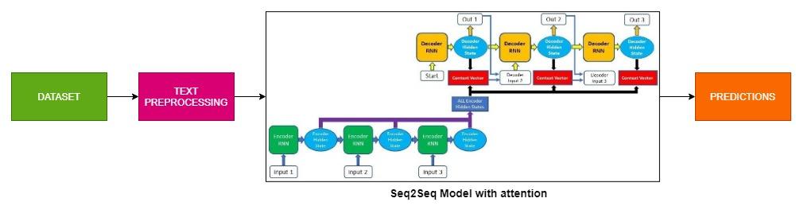
Architecture of Seq2Seq model with Attention Mechanism

Slide 17
Dataset : Cornell Movie Dialogs Corpus
This corpus contains a large metadata-rich collection of fictional conversations extracted from raw movie scripts.
220,579 conversational exchanges between 10,292 pairs of movie characters
Involves 9,035 characters from 617 movies
In total 304,713 utterances
Movie metadata included:
Genres
Release year
IMDB rating
Number of IMDB votes
Character metadata included:
Gender (for 3,774 characters)
Position on movie credits (3,321 characters)

Slide 18
TECHNICAL STACK
Google Colab
NumPy Stack(NumPy, Pandas, SciPy, Matplotlib)
TensorFlow 1.4
Flask

Slide 19
IMPLEMENTATION & ALGORITHM
Load dataset into colab notebook
Pre-process the data
Build the Seq2Seq model with attention
Split the data to encoder and decoder inputs
Train the model
Evaluate the model with predictions

Slide 20
Preprocessing-I
Step 1:
Read from 'movie_conversations.txt'
Create a list of [list of line_id's]
Output Ex: ['L194', 'L195', 'L196', 'L197']
Step 2:
Read from 'movie-lines.txt'
Create a dictionary with ( key = line_id, value = text )
They do not!
They do to!
I hope so.
She okay?
Let's go.
Wow
Okay -- you're gonna need to learn how to lie.
No
I'm kidding. You know how sometimes you just become this "persona"? And you don't know how to quit?

Slide 21
Preprocessing-II
Step 3:
Get lists of all conversations as Questions and Answers
[questions]
[answers]
Question and answers are come from same conversation. As because there will be a question with the response.
Ex: For our first conversation
Q Can we make this quick? Roxanne Korrine and Andrew Barrett are having an incredibly horrendous public break- up on the quad. Again.
A Well, I thought we'd start with pronunciation, if that's okay with you.
Step 4:
Clean Text:
Text to lowercase
Replacing certain words as follow:
Ex:
text = re.sub(r"i'm", "i am", text)
text = re.sub(r"he's", "he is", text)
text = re.sub(r"she's", "she is", text)

Slide 22
Preprocessing-III
Step 5:
Filter out the Questions and Answers that are too short/long
Minimum & Maximum length are 2 & 5
Step 6:
Get each word and its count from filtered questions and answers in vocab dictionary
Get each word and its count from filtered questions and answers in Question and Answer vocab dictionary
Step 7:
Create vocabulary index with total number of words appear more than 2 times in vocab dictionary
6281 words which appear more appear more than 2 times
Step 8:
For each codes(<EOS>,<PAD>,<UNK><GO>) ,increment vocabulary index to 1 for each existing code
Same for question and answer vocab.
Now vocab index will be 6285

Slide 23
Preprocessing-IV
Step 9:
Create index vocabulary from vocabulary index dictionary
index vocabulary dict_items([(0, 'what'), (1, 'good'), (2, 'stuff'), (3, 'she'), (4, 'okay'), (5, 'they'),......
......., (6283, '<PAD>'), (6284, '<EOS>'), (6285, '<UNK>'), (6286, '<GO>')])
Step 10:
Add EOS tag at the end of each answer
Ex: the real you → the real you <EOS>
Step 11:
Again filter out words in by comparing words in filtered question and words in vocabulary index and replace the words that are not present in the vocabulary index dictionary with the <UNK> tag.
Do the same for filtered answer

Slide 24
Initial Configurations
target_vocab_size = len(answers_vocabs)
source_vocab_size = len(questions_vocabs)
vocab_size = len(index_to_vocabs)+1
embed_size = 1024
rnn_size = 1024
batch_size = 32
num_layers = 3
learning_rate = 0.001
learning_rate_decay = 0.99
min_lr = 0.0001
#keep_prob = 0.5
epochs=50
DISPLAY_STEP=30
Optimizer: Adam
Loss: Weighted Cross Entropy
Activation functions:Sigmoid,Softmax

Slide 25
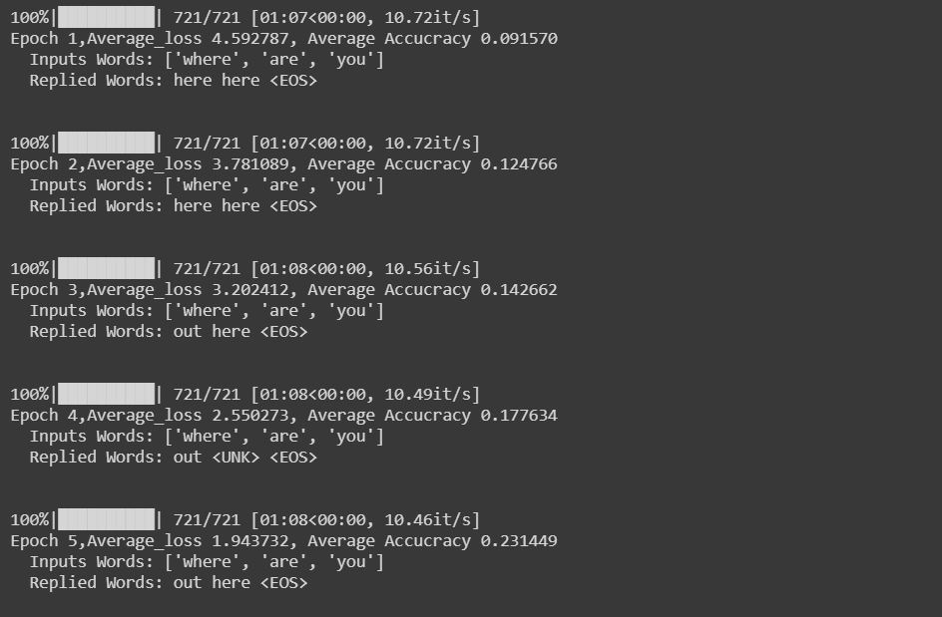
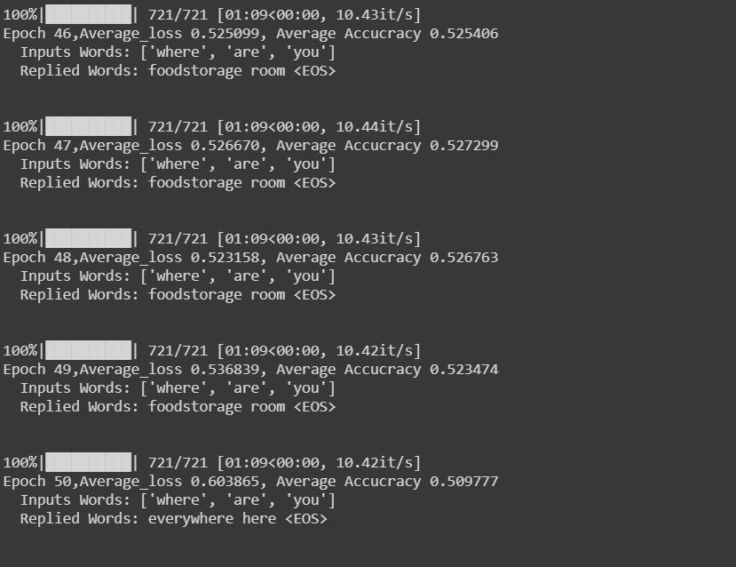
Epochs
Initial epochs Final epochs

Slide 26
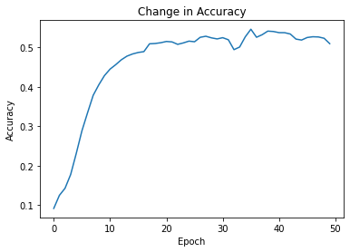
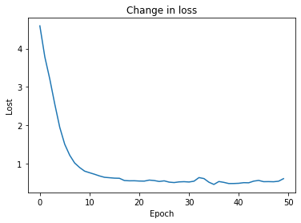
Accuracy and Loss

Slide 27
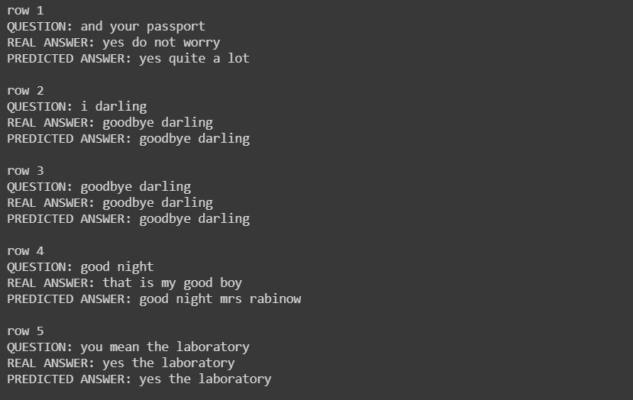
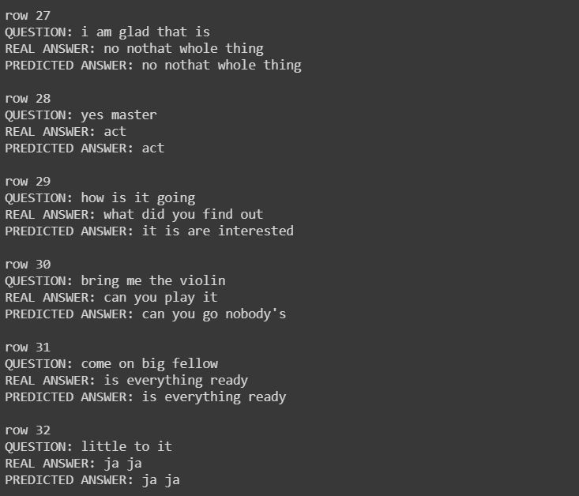
Test

Slide 28
Future Works
Optimize the model further by hyperparameter tuning.
To implement web application using flask with the model built.

Slide 29
REFERENCES
1. K. Cho, B. van Merrienboer, C. Gulcehre, D. Bahdanau, F. Bougares, H. Schwenk, and Y. Bengio (2014) Learning Phrase Representations using RNN Encoder-Decoder for Statistical Machine Translation (https://arxiv.org/pdf/1406.1078.pdf)
2. D. Bahdanau, K. Cho, and Y. Bengio (2014) Neural Machine Translation by Jointly Learning to Align and Translate (https://arxiv.org/pdf/1409.0473.pdf)
3. I. Sutskever, O. Vinyals, and Q. Le. CoRR (2014) Sequence to Sequence Learning with Neural Networks(https://arxiv.org/pdf/1409.3215.pdf)
4. O. Vinyals, and Q. Le. (2015) A Neural Conversational Model (https://arxiv.org/pdf/1506.05869.pdf)
5. A. Sordoni, M. Galley, M. Auli, C. Brockett, Y. Ji, M. Mitchell, J.-Y. Nie, J. Gao, B. Dolan. 2015. A Neural Network Approach to Context-Sensitive Generation of Conversational Responses.( https://arxiv.org/pdf/1506.06714.pdf)
6. K. Yao, G. Zweig, and B. Peng (2015) Attention with Intention for a Neural Network Conversation Model(https://arxiv.org/pdf/1510.08565.pdf)
7. J. Li, M. Galley, C. Brockett, G. Spithourakis, J. Gao, and B. Dolan. (2016) A Persona-Based Neural Conversation Model (https://arxiv.org/pdf/1603.06155.pdf)

Slide 30


